Slide 1


Adventure works cycle

Slide 2

Adventure works cycle
PRESENTED BY :
Priyanka Puluskar
Sidra Manchekar

Slide 3
Introduction
This analysis project aims to extract valuable insights from structured sales data to support business decision-making.
Goal: Generate actionable insights through sales and performance analysis
Dataset: Adventure Works Cycle dataset (2010–2014)
Tools & Platforms: SQL, Excel, Tableau, Power BI

Slide 4
SCOPE
The scope of this project includes analyzing sales, profit, and production cost data to identify trends and measure business performance.
Analysis of large-scale Adventure Works Cycle dataset
Data cleaning and transformation using Excel and SQL
Identification and calculation of key sales KPIs
Development of interactive dashboards in Tableau and Power BI
Comparative analysis across time periods, regions, and products
Generation of actionable business insights and recommendations

Slide 5
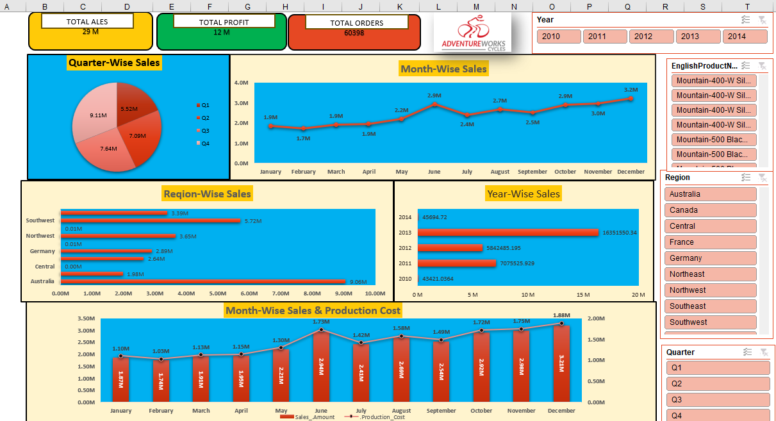
Excel Dashboard
Excel dashboard used for data cleaning and initial analysis
Pivot tables and charts created for sales and cost summary
Helped in validating KPIs before visualization

Slide 6
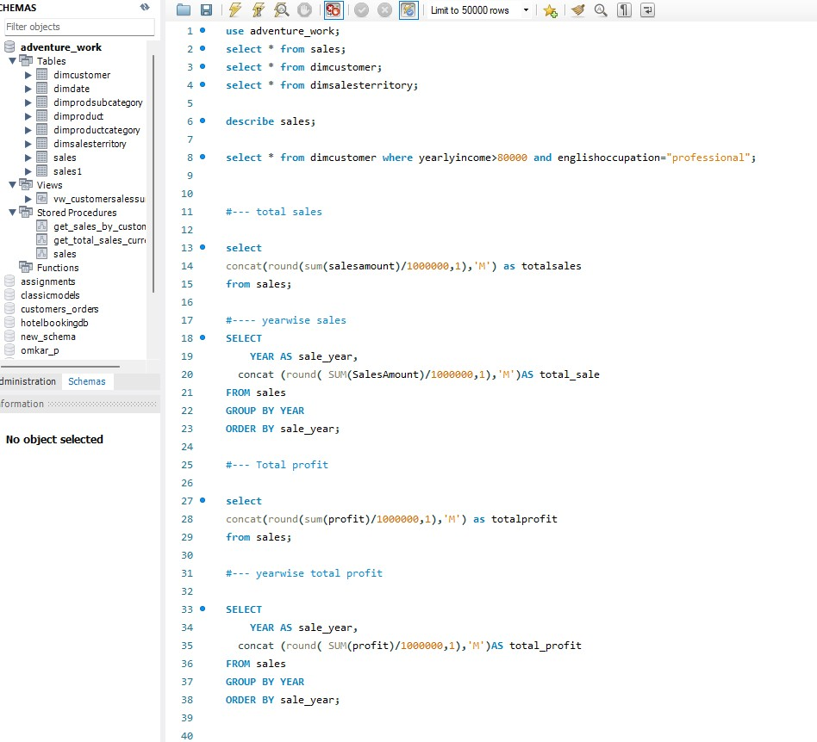
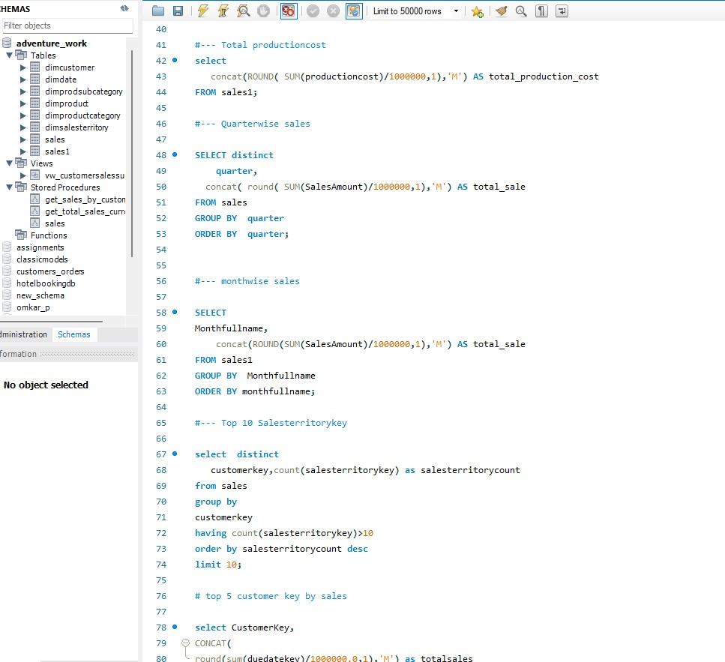
SQL QUERY

Slide 7
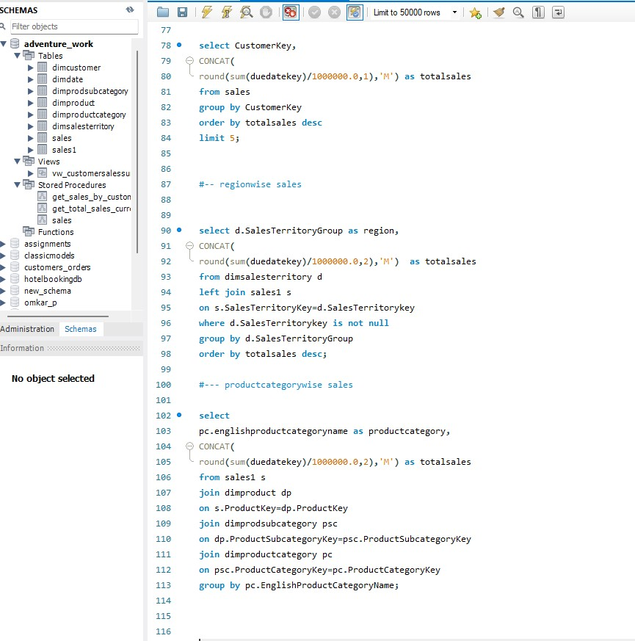
Executive Sales KPI Snapshot
Total Revenue: Business size & overall sales performance
Total Profit: Profitability and pricing effectiveness
Production Cost: Operational cost efficiency
Profit Margin (YoY): Efficiency improvement over time
YoY Sales Growth: Long-term business growth tracking
Quarterly Sales: Seasonal performance identification
Monthly Sales Trend: Short-term demand monitoring
High-Value Customers: Identify premium revenue contributors
Top 5 Customers: Revenue concentration analysis
Top Sales Regions: Geographic performance focus
Top Product Categories: Product-level growth drivers

Slide 8
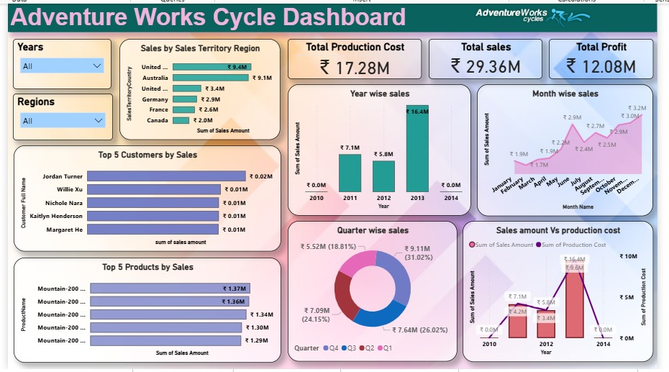
Power BI Dashboard
Provides consolidated KPIs such as total sales, profit, and cost
Displays year-wise, month-wise, and quarter-wise sales trends
Supports quick business-level decision-making

Slide 9
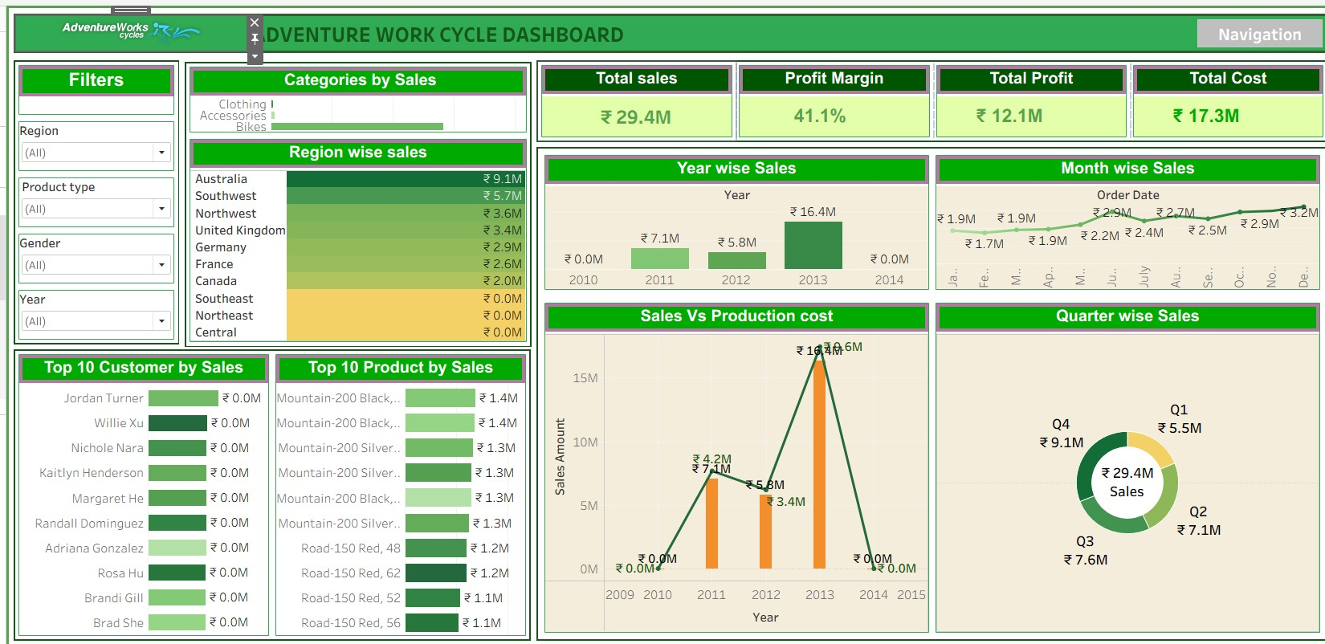
Tablue Dashboard
Interactive dashboard with filters for year, region, and product
Displays sales trends, top products, and regional performance
Enables drill-down analysis for detailed insights

Slide 10
FINAL INSIGHTS
In summary, the dashboard shows:
Total Sales of ₹29.4M with a strong profit margin
Sales peaked in 2013 across all years
Q4 and year-end months generate the highest revenue
Bikes are the primary revenue-generating products
USA and Australia are the strongest performing regions

Slide 11
CONCLUSION
This project successfully transformed raw Adventure Works Cycle data into meaningful insights using SQL, Excel, Tableau, and Power BI.
The analysis highlighted key sales trends, regional performance, and product contribution that support informed business decisions.
Overall, the project demonstrates the importance of data analytics in improving sales strategy and business planning.

Slide 12

Adventure Work Cycle

